Slide 1
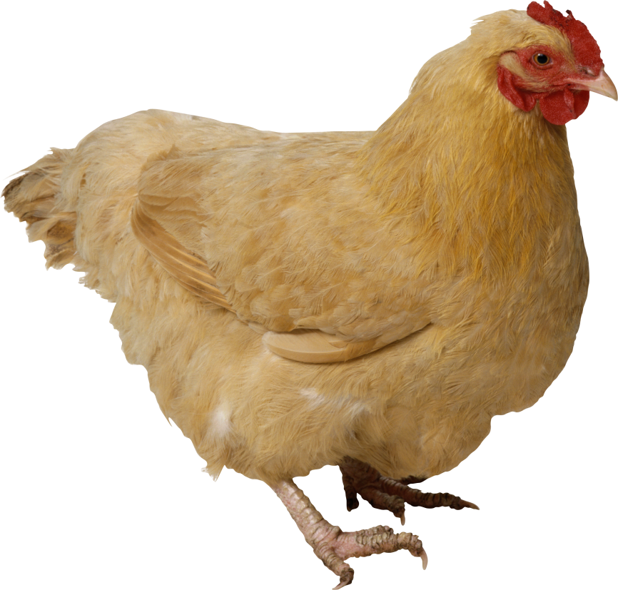
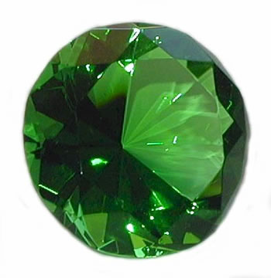
What do these pictures have in common?

Slide 2
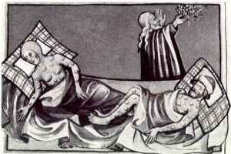
The Black Death

Slide 3
How did people try to cure the Black Death?
Learning Objectives
Identify how people in the middle ages responded to the Black Death.
Describe the different treatments people used
Explain why people believed these treatments worked.

Slide 4
Match the type of cure to the details of the cure (the first one is done for you)
Bleeding |  | If a person gets the disease, they must be put to bed. They should be washed with vinegar and rose water
Eating the right foods |  | The buboes should be cut open to allow the disease to leave the body. The buboes should be cut open with a red pot poker.
Herbal Remedies |  | The disease must be in the blood. The veins leading to the heart should be cut open. This will allow the disease to leave the body. An ointment made of clay and violets should be applied to the place where the cuts have been made.
Magic |  | We should not eat food that goes off easily and smells badly such as meat, cheese and fish. Instead we should eat bread, fruit and vegetables
Lancing the buboes |  | The streets should be cleaned of all human and animal waste. It should be taken by a cart to a field outside of the village and burnt. All bodies should be buried in deep pits outside of the village and their clothes should also be burnt.
Sanitation in towns |  | Roast the shells of newly laid eggs. Ground the roasted shells into a powder. Chop up the leaves and petals of marigold flowers. Put the egg shells and marigolds into a pot of good ale. Add treacle and warm over a fire. The patient should drink this mixture every morning and night.
Keeping clean |  | Place a live hen next to the swelling to draw out the pestilence from the body.

Slide 5
Name that cure!
Use your evidence pack and work in pairs – make a list in your book of how you think these items were used to cure the plague!

Slide 6
Some of the cures they tried included:
Sitting close to a fire or in a sewer to drive out the fever, or fumigating the house with herbs to purify the air.
Bells: People believed that loud noises would scare evil spirits from the town. They would ring church bells loudly and shoot cannons all night to try and save their town from the spread of plague
One man came up with a treatment that spread far and wide.
He told people to shave the bottom of a live chicken and strap it to their swollen buboes.
They thought this would suck out the poison and save the victim.
Drinking vinegar, eating crushed minerals, arsenic, mercury or even ten-year-old treacle!
People who believed God was punishing you for your sin, 'flagellants', went on processions whipping themselves.
Doctors often tested urine for colour and health. Some even tasted it to test.
Rubbing onions, herbs or a chopped up snake (if available) on the boils or cutting up a pigeon and rubbing it over an infected body.

Slide 7
Pick a cure:
Create an advert poster telling people how to cure the Black Death.
Success Criteria:
Make sure you give a detailed description of what your cure is (what ingredients or equipment you need, what you need to do with them....)
Explain why your cure works – how is it effective?
Include pictures and colour
TASK:

Slide 8
In Medieval England, the Black Death was to kill 1.5 million people out of an estimated total of 4 million people between 1348 and 1350.

